Slide 1
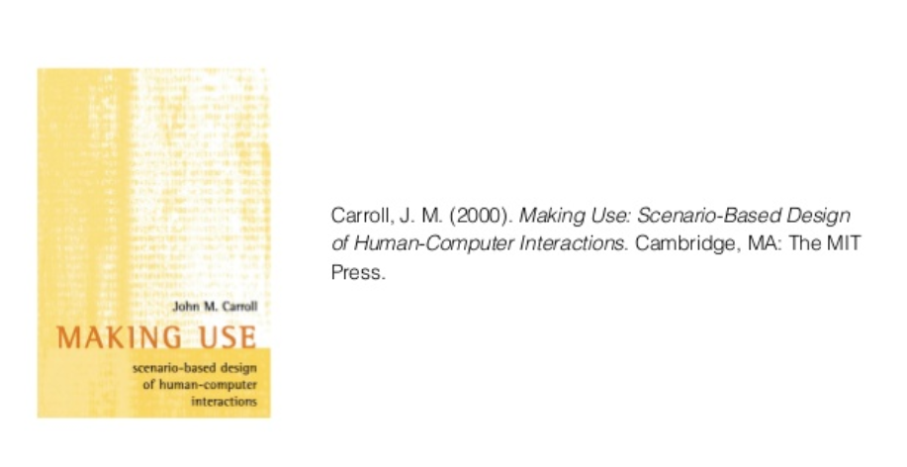
Scenario Based Design
Amir Dirin

Slide 2
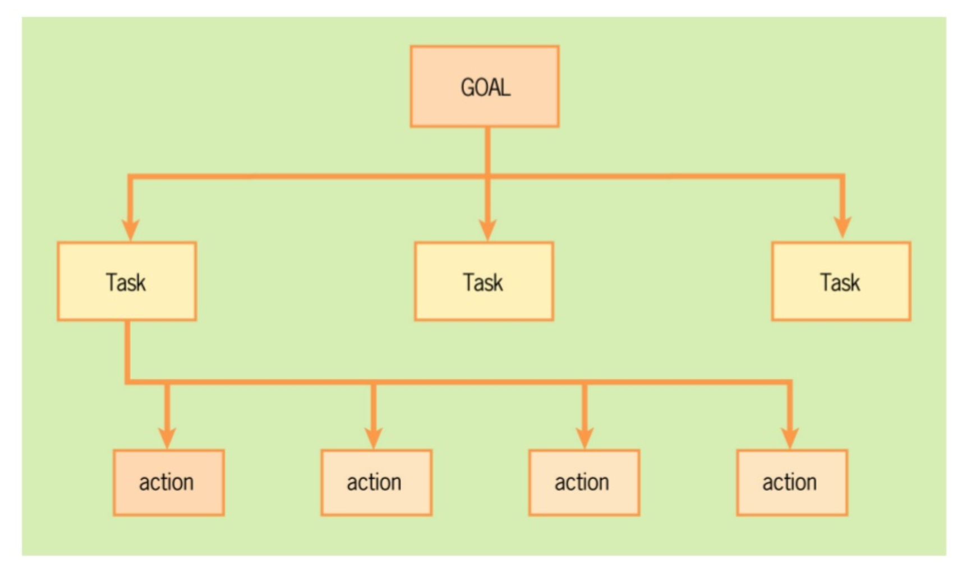
GOAL / TASKS / Action

Slide 3
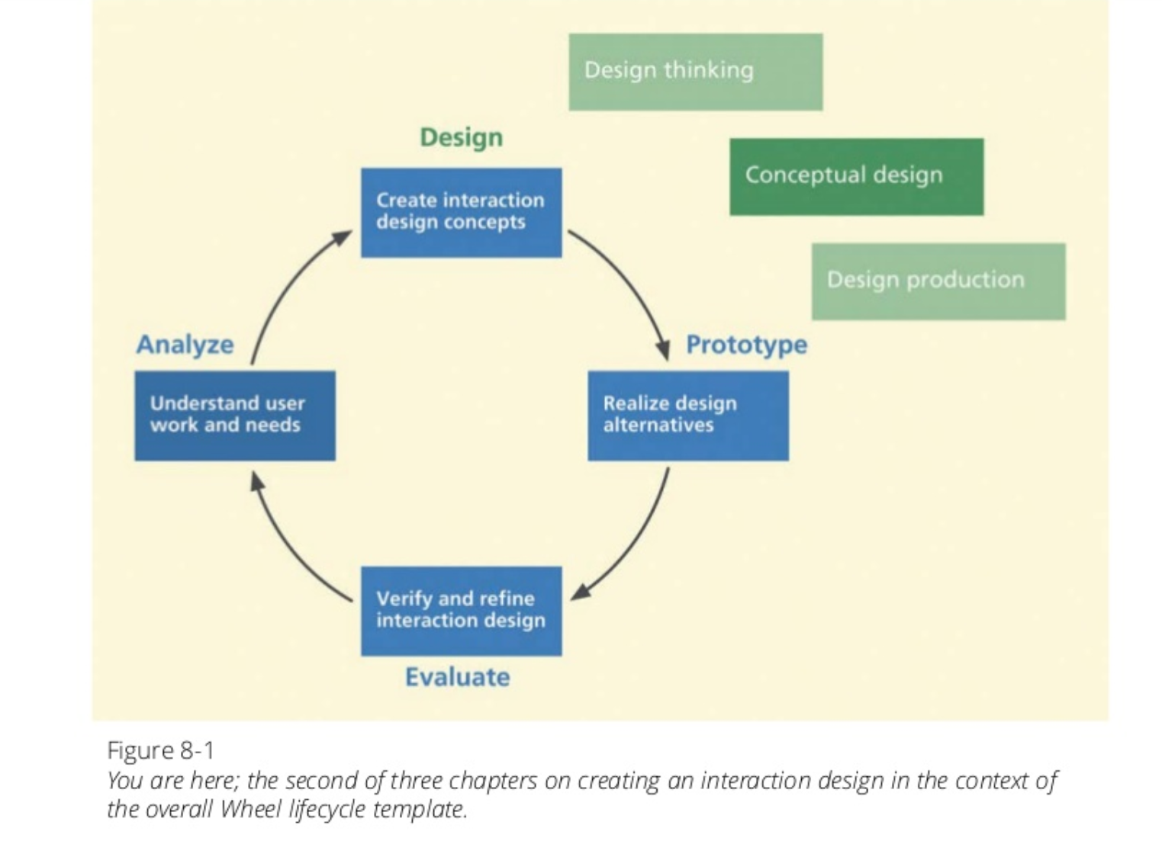
Concept Design

Slide 4
Concept Design
Designer’s Mental Model
Vision of how system works as held by designer
What the system is
How it is organized
What it does and how
User’s Mental Model
Description of how system works as held by user
Conceptual design is what we use to connect the two

Slide 5
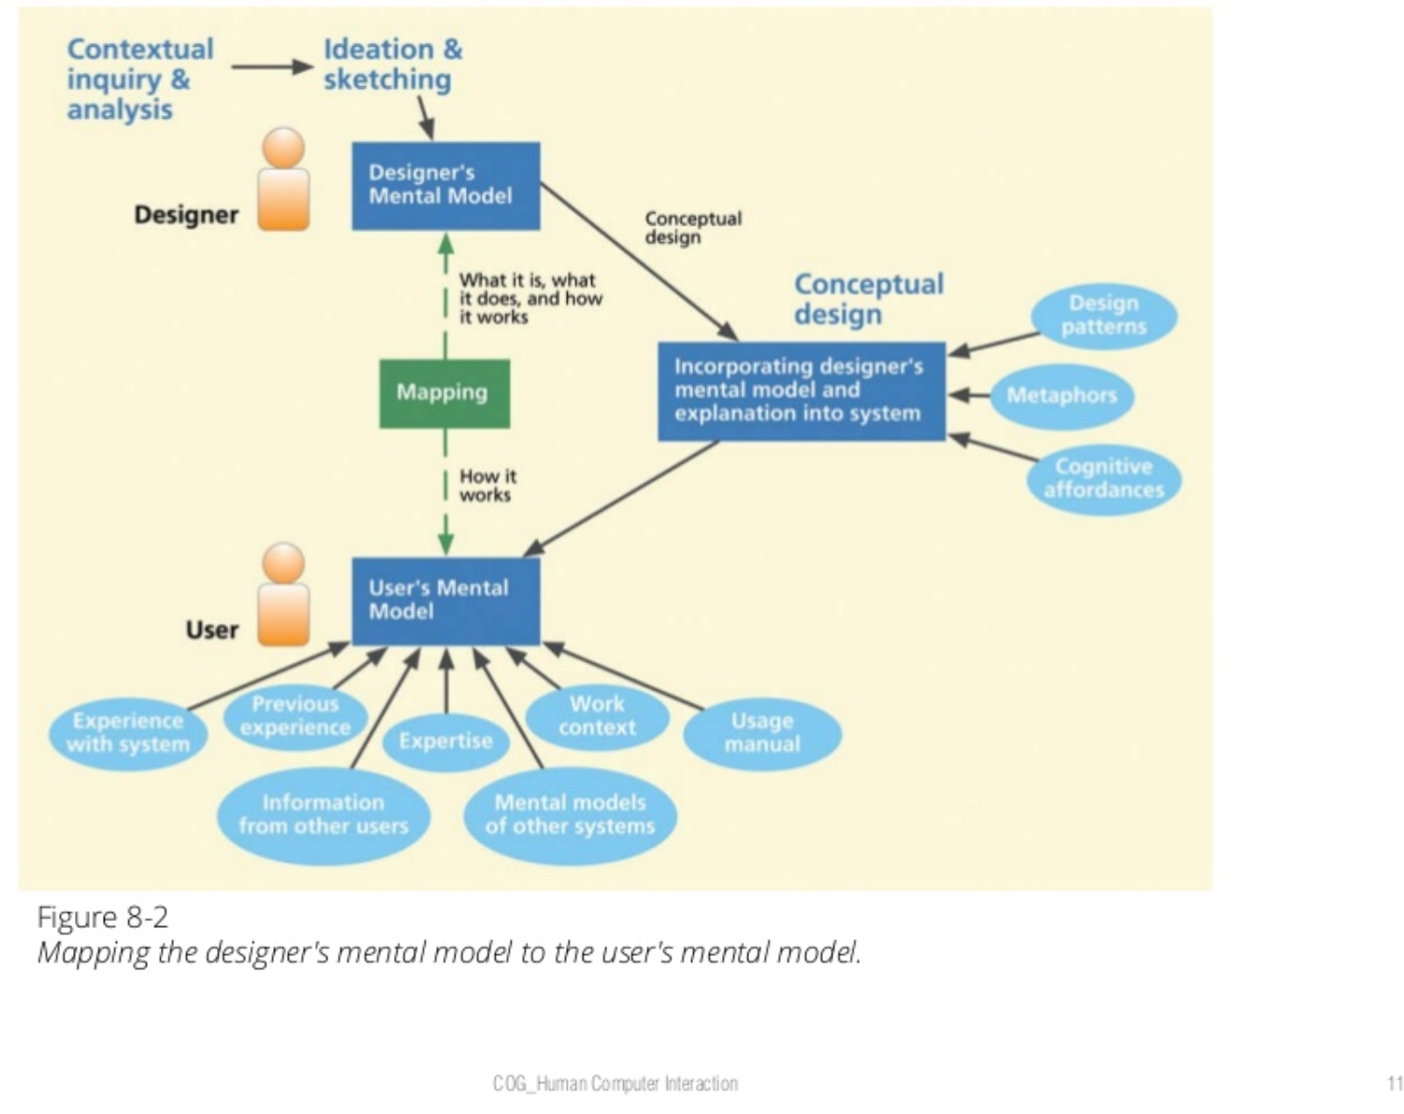
Mental Models

Slide 6
Describing users stories about how they imagine to use the system or the application.

Slide 7
Definition
A scenario can be defined as a description of a possible set of events that might reasonably take place (M.Jarke 98)
A scenario is a sequence of interactions between the user and the system (Potts 94)

Slide 8
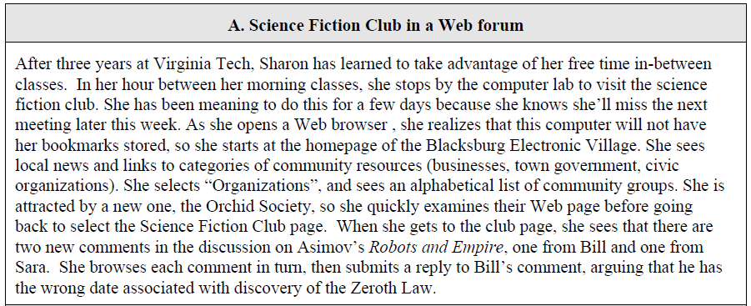
Example

Slide 9
Definition
A scenario is a description involving:
An individual user,
Interacting with a software system,
To obtain a specific result,
In specific conditions,
During a limited period of time
(Nielsen 95)

Slide 10
Definition
A scenario is a description of the behavior of the system and of its environment which manifests in specific situations (Benner 93)

Slide 11
Scenario-based design
Simulation of future (envisioned) use
A textual description with (or without) screen mock ups depicting an imagined sequence of interactions with a simulated system
The context of the setting should be included in the description, so that the scenario is meaningful to as many as possible.
Two types:
Generic (domain independent)
Specific (domain specific)

Slide 12
Scenario Elements
Setting Where? When?
Actors (who?)
Task goals (why?)
Plans (how do they plan to accomplish it?)
Actions (What do we see the actors do)
Events (System / application response)
Evaluation (IS that what the users wanted?)

Slide 13
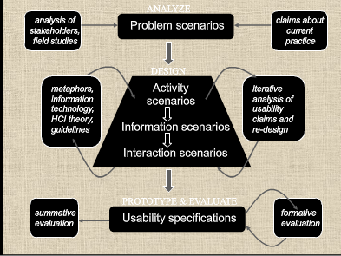
In Real-life Scenario design

Slide 14
StoryBoard

Slide 15
Check this out
https://storytribe.ae/public/stories

Slide 16
Storyboards
Often used with scenarios, bringing more detail, and a chance to role play
It is a series of sketches showing how a user might progress through a task using the device

Slide 17
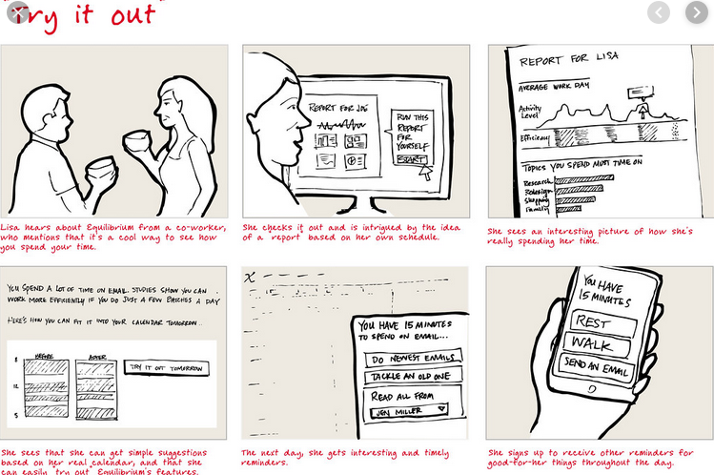
Storyboards

Slide 18
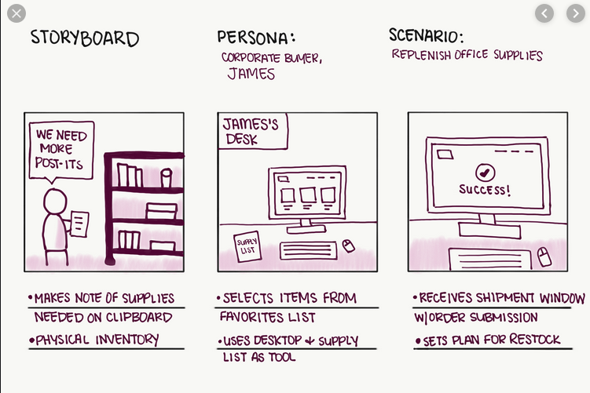

Slide 19
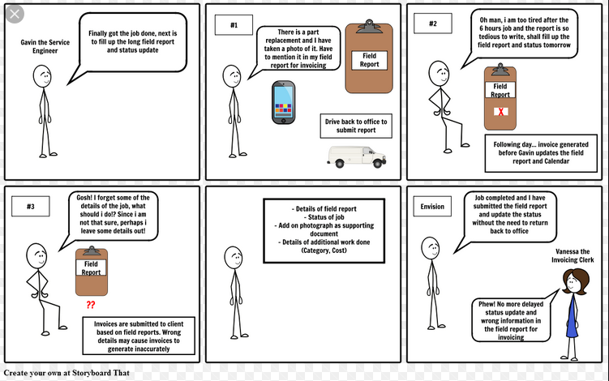

Slide 20
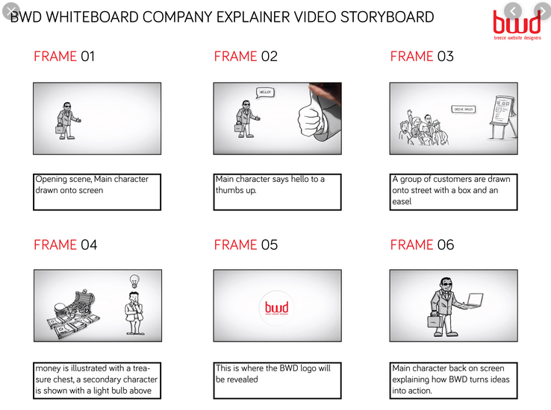

Slide 21
Participatory design sessions
3-5 participants
Structured discussions
Prepared questions about the scenarios
Did the scenario wake-up any thoughts?
What else is missing?
Is there something you would like to change in the scenario?

Slide 22
Your Tasks for The rest of the week

Slide 23
Your Tasks for this week and next week
Write a scenario based on the task list (The list of requirements that you have already came up during last week)
submission deadline for the scenario is at XXXX.
You have to test the scenario with 3-5 users and submit the revised version of your scenario (based on users' feedback) by XXXXXX
At least two new users must review your scenario, the rest of the users are those whom you had already conducted your initial user study at the elicitation phase.

Slide 24
Example of scenario

Slide 25
Scenario I. Example
Matti is a lecturer at IPS laboratory. He has been teaching programing course every fall for the last three years. More than 700 students usually participate in his lecture…
Matti has to Co-ordinate everything long before the course starts.First and the most important is to find assistants in order to help him outduring the course. He usually sends the open vacancy to different vaccancy news groups. He also contacts the previous course assistants if they would like to ontinue for next semester…
How to create scenario-based wireframe
https://www.youtube.com/watch?v=qYUeoSfL8sw

Slide 26
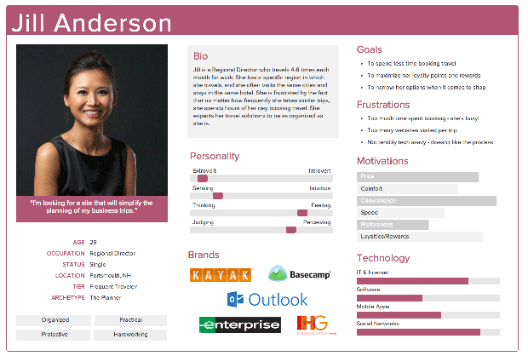
PERSONA

Slide 27
